Slide 1
Periodic Table
10th Grade
1 H |  |  |  |  |  |  |  |  |  |  |  |  |  |  |  |  | 2 He
3 Li | 4 Be |  |  |  |  |  |  |  |  |  |  | 5 B | 6 C | 7 N | 8 O | 9 F | 10 Ne
11 Na | 12 Mg |  |  |  |  |  |  |  |  |  |  | 13 Al | 14 Si | 15 P | 16 S | 17 Cl | 18 Ar
19 K | 20 Ca | 21 Sc | 22 Ti | 23 V | 24 Cr | 25 Mn | 26 Fe | 27 Co | 28 Ni | 29 Cu | 30 Zn | 31 Ga | 32 Ge | 33 As | 34 Se | 35 Br | 36 Kr
37 Rb | 38 Sr | 39 Y | 40 Zr | 41 Nb | 42 Mo | 43 Tc | 44 Ru | 45 Rh | 46 Pd | 47 Ag | 48 Cd | 49 In | 50 Sn | 51 Sb | 52 Te | 53 I | 54 Xe
55 Cs | 56 Ba | 71 Lu | 72 Hf | 73 Ta | 74 W | 75 Re | 76 Os | 77 Ir | 78 Pt | 79 Au | 80 Hg | 81 Tl | 82 Pb | 83 Bi | 84 Po | 85 At | 86 Rn
87 Fr | 88 Ra | 103 Lr | 104 Rf | 105 Db | 106 Sg | 107 Bh | 108 Hs | 109 Mt | 110 Ds | 111 Rg | 112 Cn | 113 Nh | 114 Fl | 115 Mc | 116 Lv | 117 Ts | 118 Og
 |  | 57 La | 58 Ce | 59 Pr | 60 Nd | 61 Pm | 62 Sm | 63 Eu | 64 Gd | 65 Tb | 66 Dy | 67 Ho | 68 Er | 69 Tm | 70 Yb
 |  | 89 Ac | 90 Th | 91 Pa | 92 U | 93 Np | 94 Pu | 95 Am | 96 Cm | 97 Bk | 98 Cf | 99 Es | 100 Fm | 101 Md | 102 No
Metal
Metalloid
Nonmetal
Recently discovered
Here is where your presentation begins
Wei Lai
Lanthanides
Actinides

Slide 2
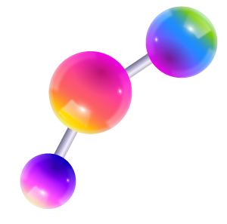
—Ernest Klein
What the elements are to chemistry, what the sounds are to music, are words to language.

Slide 3
177 million
is the number of organic and inorganic substances

Slide 4
Contents
Introduction
History
Shapes

Slide 5
01
Introduction
You can enter a subtitle here if you need it

Slide 6
Periodic table
The periodic table, also known as the periodic table of (the) (chemical) elements, is a tabular display of the chemical elements. It is widely used in chemistry, physics, and other sciences, and is generally seen as an icon of chemistry. It is a graphic formulation of the periodic law, which states that the properties of the chemical elements exhibit a periodic dependence on their atomic numbers.

Slide 7
Reading the periodic table
Atomic Number
Jupiter
6
Symbol
C
Jupiter
Name
Jupiter
Carbon
12.0116
Relavtive Atomic Mass
Jupiter

Slide 8
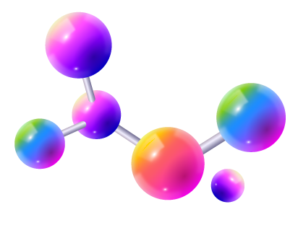
Why do We Need Classification Elements ?

Slide 9

Does the Modern Periodic Table Change? If So, How and Who Does That?

Slide 10
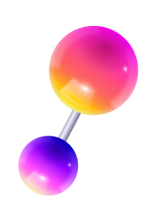
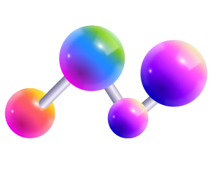
Awesome words

Slide 11
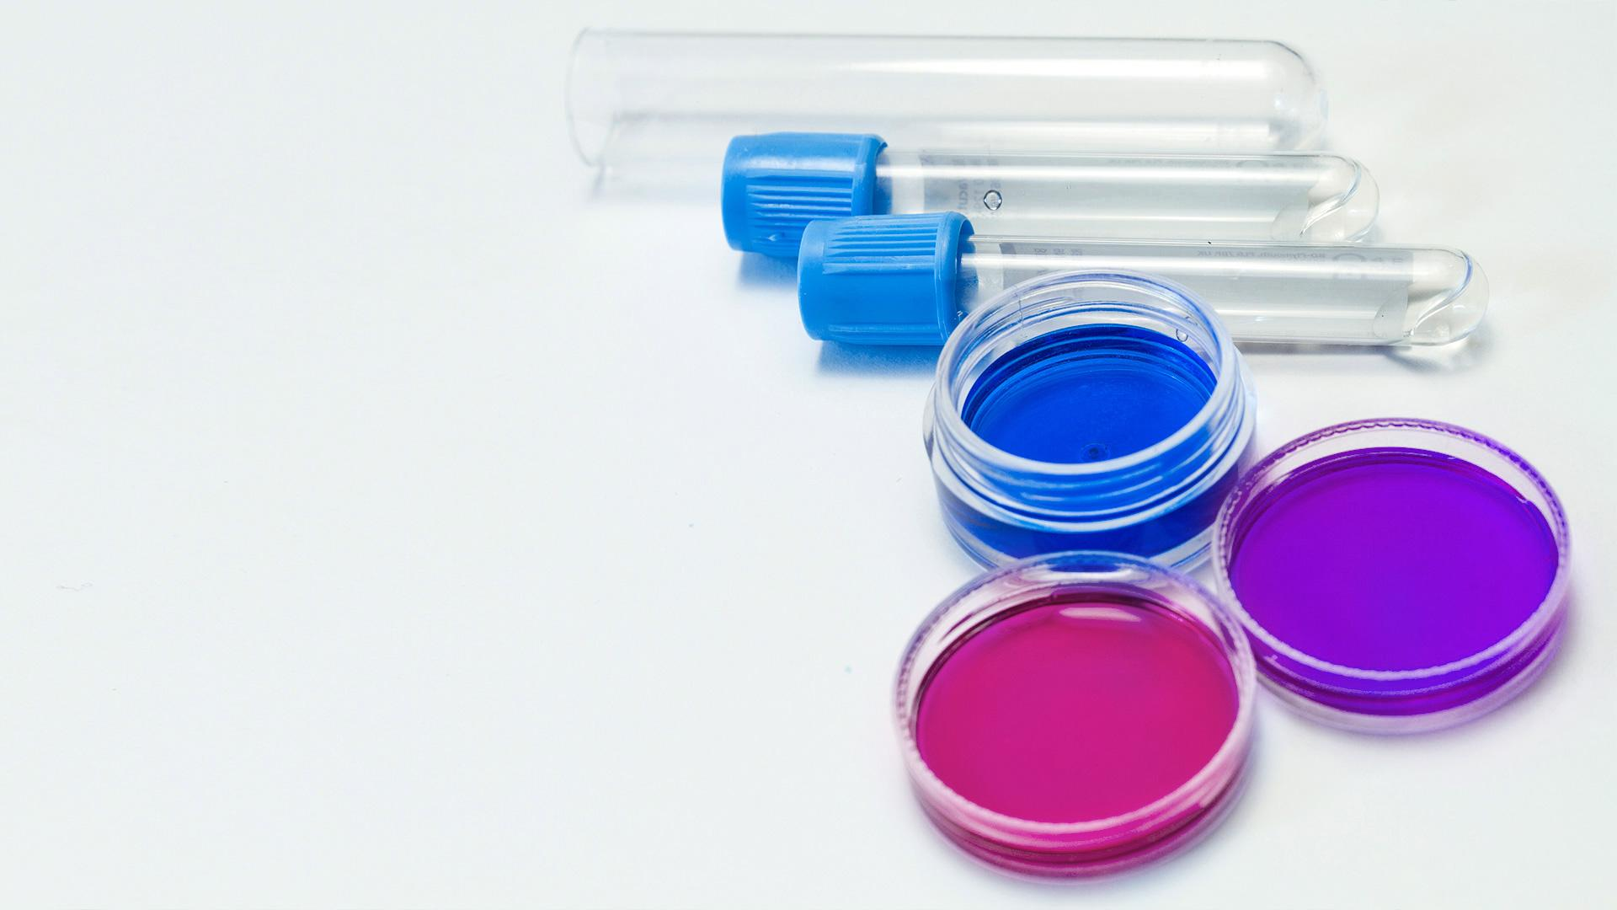
A picture is worth a thousand words

Slide 12
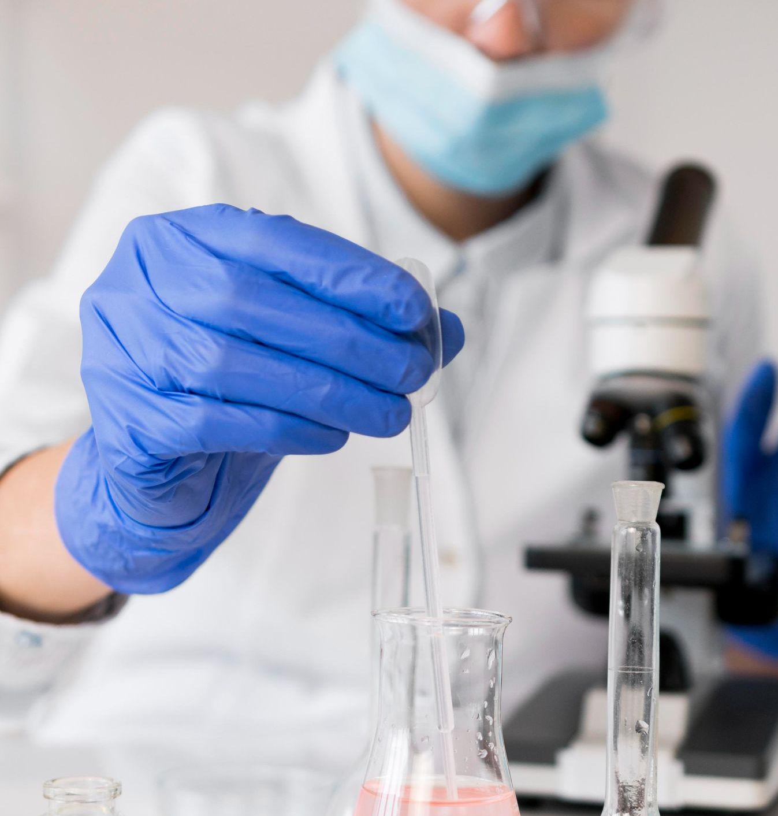
A picture always reinforces
the concept
Images reveal large amounts of data, so remember: use an image instead of a long text. Your audience will appreciate it

Slide 13
02
History
You can enter a subtitle here if you need it

Slide 14
Periodic table timeline
A.E.B. de Chancourtois
Dmitri Mendeleyev
1862
1882
01
02
03
04
05
1829
1865
NOW
Johann Dobereiner
John Alexander Newlands

Slide 15
9h 55m 23s
333,000
386,000 km
is Jupiter's rotation period
Earths is the Sun’s mass
is the distance between Earth and the Moon

Slide 16
Most useful tools
27%
55%
78%
90%
Beakers
Test tubes
Funnels
Droppers
Mercury is the smallest planet
Earth is the third planet from the Sun
Despite being red, Mars is a cold place
Jupiter is the biggest planet of them all

Slide 17

Desktop app
You can replace the image on the screen with your own work. Just right-click on it and select “Replace image”

Slide 18

Tablet app
You can replace the image on the screen with your own work. Just right-click on it and select “Replace image”

Slide 19

Smartphone
You can replace the image on the screen with your own work. Just right-click on it and select “Replace image”

Slide 20
03
Shapes
You can enter a subtitle here if you need it

Slide 21
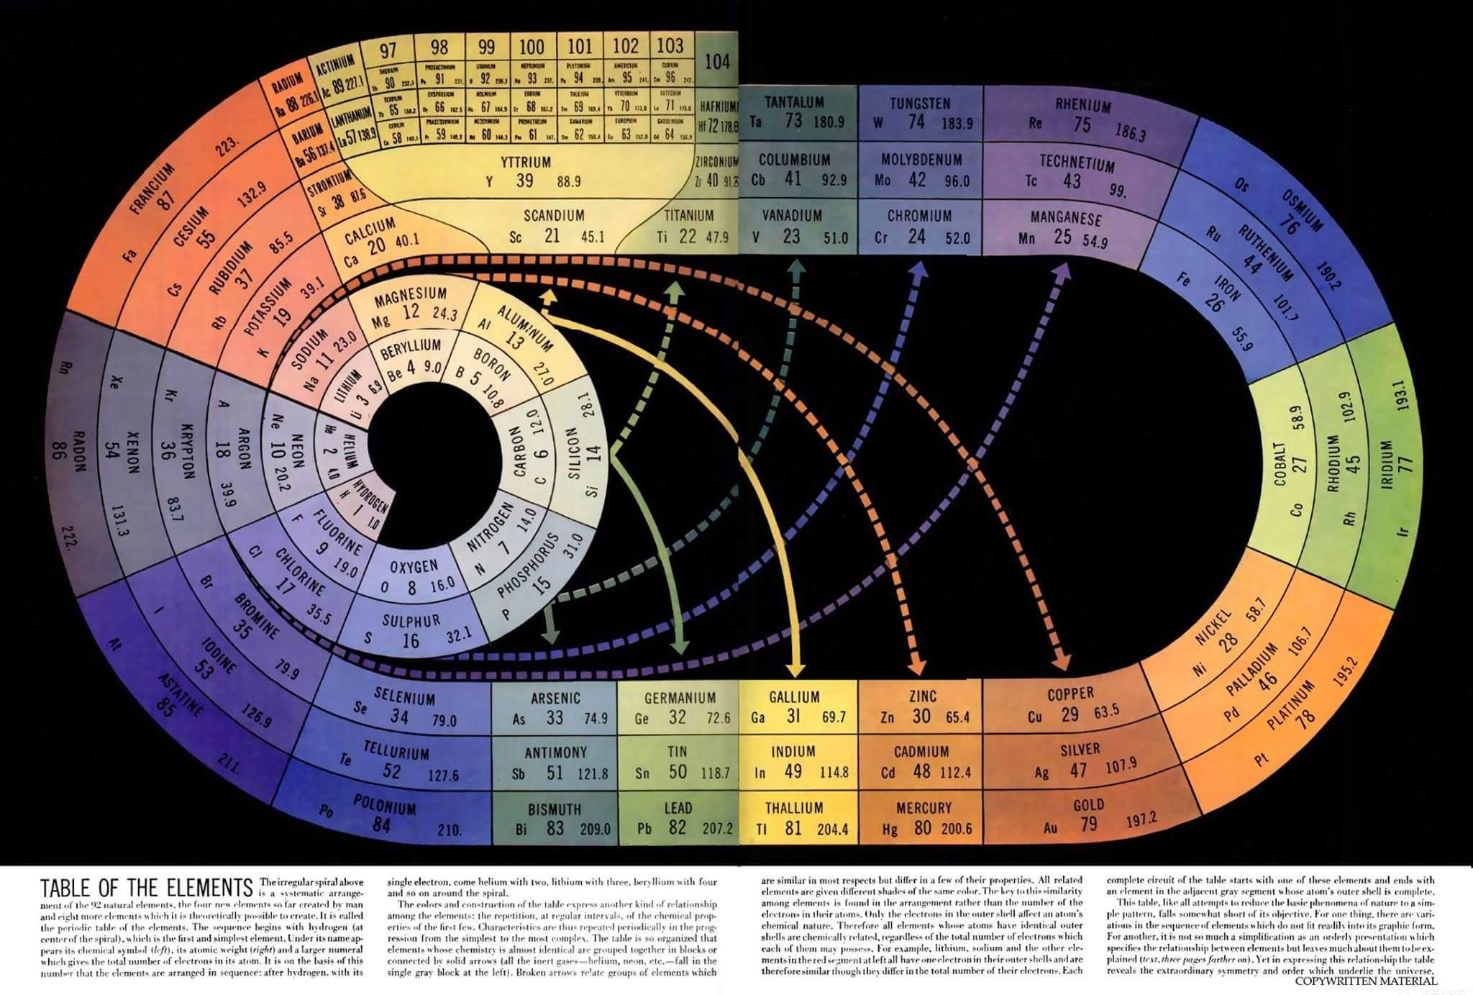

Slide 22
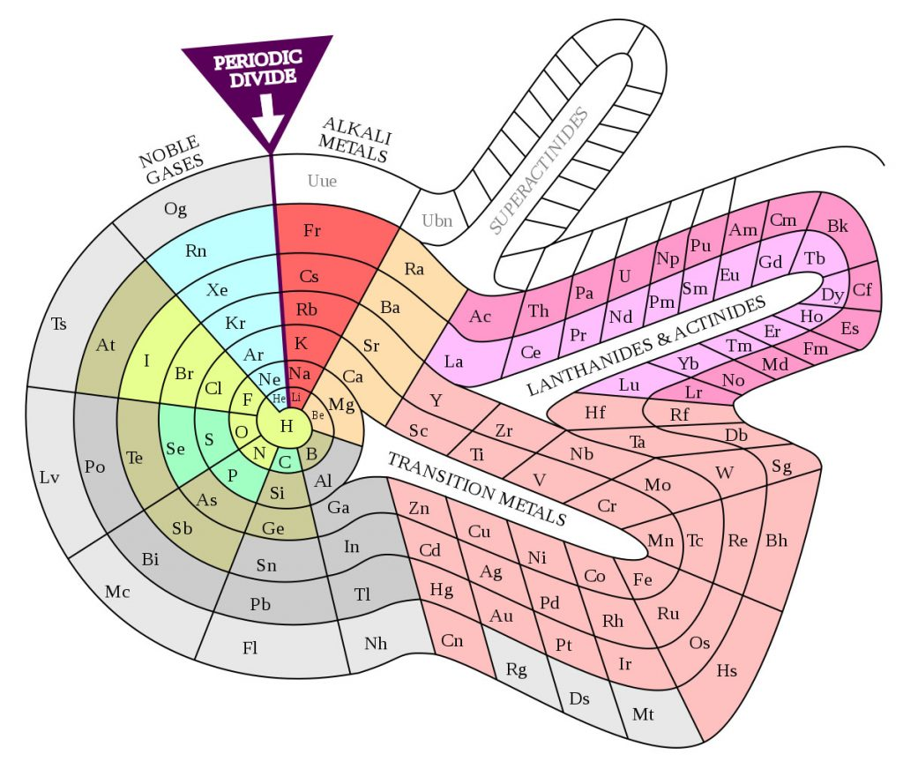

Slide 23
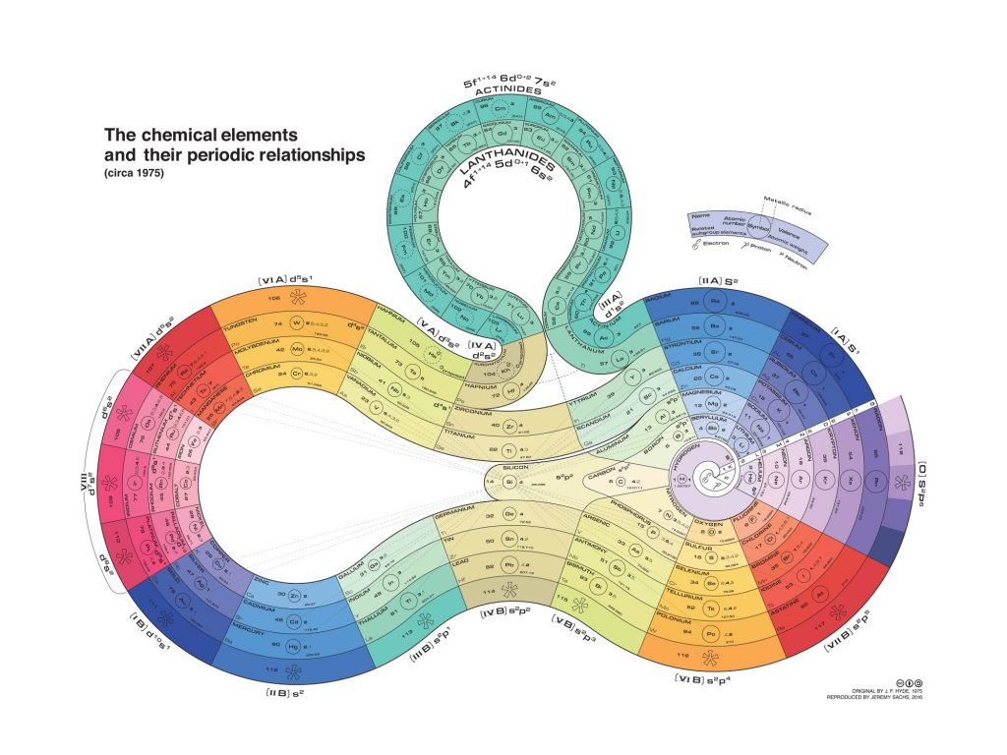

Slide 24
This is a map
Uranus
Jupiter
It’s the seventh planet from the sun
Jupiter is the biggest planet of them all

Slide 25
The periodic table of elements
1 H |  |  |  |  |  |  |  |  |  |  |  |  |  |  |  |  | 2 He
3 Li | 4 Be |  |  |  |  |  |  |  |  |  |  | 5 B | 6 C | 7 N | 8 O | 9 F | 10 Ne
11 Na | 12 Mg |  |  |  |  |  |  |  |  |  |  | 13 Al | 14 Si | 15 P | 16 S | 17 Cl | 18 Ar
19 K | 20 Ca | 21 Sc | 22 Ti | 23 V | 24 Cr | 25 Mn | 26 Fe | 27 Co | 28 Ni | 29 Cu | 30 Zn | 31 Ga | 32 Ge | 33 As | 34 Se | 35 Br | 36 Kr
37 Rb | 38 Sr | 39 Y | 40 Zr | 41 Nb | 42 Mo | 43 Tc | 44 Ru | 45 Rh | 46 Pd | 47 Ag | 48 Cd | 49 In | 50 Sn | 51 Sb | 52 Te | 53 I | 54 Xe
55 Cs | 56 Ba | 71 Lu | 72 Hf | 73 Ta | 74 W | 75 Re | 76 Os | 77 Ir | 78 Pt | 79 Au | 80 Hg | 81 Tl | 82 Pb | 83 Bi | 84 Po | 85 At | 86 Rn
87 Fr | 88 Ra | 103 Lr | 104 Rf | 105 Db | 106 Sg | 107 Bh | 108 Hs | 109 Mt | 110 Ds | 111 Rg | 112 Cn | 113 Nh | 114 Fl | 115 Mc | 116 Lv | 117 Ts | 118 Og
 |  | 57 La | 58 Ce | 59 Pr | 60 Nd | 61 Pm | 62 Sm | 63 Eu | 64 Gd | 65 Tb | 66 Dy | 67 Ho | 68 Er | 69 Tm | 70 Yb
 |  | 89 Ac | 90 Th | 91 Pa | 92 U | 93 Np | 94 Pu | 95 Am | 96 Cm | 97 Bk | 98 Cf | 99 Es | 100 Fm | 101 Md | 102 No
Metal
Metalloid
Nonmetal
Recently discovered
Lanthanides
Actinides

Slide 26
Metals and nonmetals
Metals
Nonmetals
Uranus is the seventh planet from the sun
Mercury is the closest planet to the Sun
Jupiter is the biggest planet of them all
Neptune is the farthest planet from the Sun
Earth is the planet where we all live
Despite being red, Mars is a cold place
Saturn is a gas giant and has several rings
Venus is the second planet from the Sun
VS

Slide 27
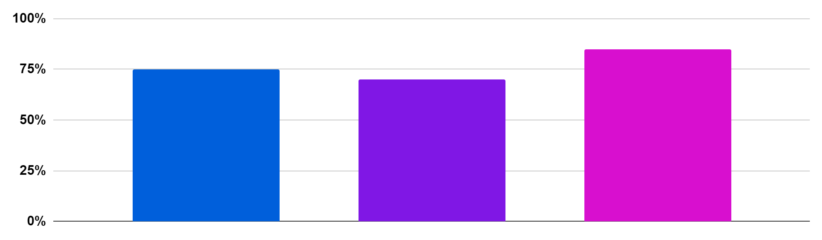
Metals, nonmetals and metalloids
Metals
Nonmetals
Metalloids
Jupiter is the biggest planet of them all
Despite being red, Mars is a cold place
Neptune is very far from the Sun
75%
70%
85%
Follow the link in the graph to modify its data and then paste the new one here. For more info, click here

Slide 28
The composition
H2O
H
H
O
Hydrogen
Hydrogen
Oxygen
Venus has high temperatures
Jupiter is the biggest planet
Saturn is a gas giant and it has several rings

Slide 29
Thanks!
Do you have any questions?
youremail@freepik.com
+91 620 421 838
yourcompany.com
Please keep this slide for attribution

Slide 30
Icon pack: chemistry

Slide 31
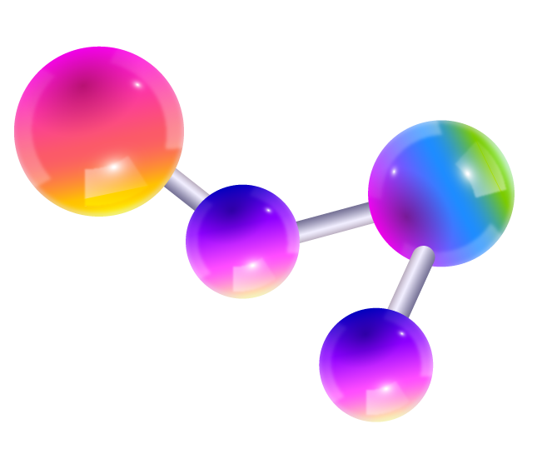
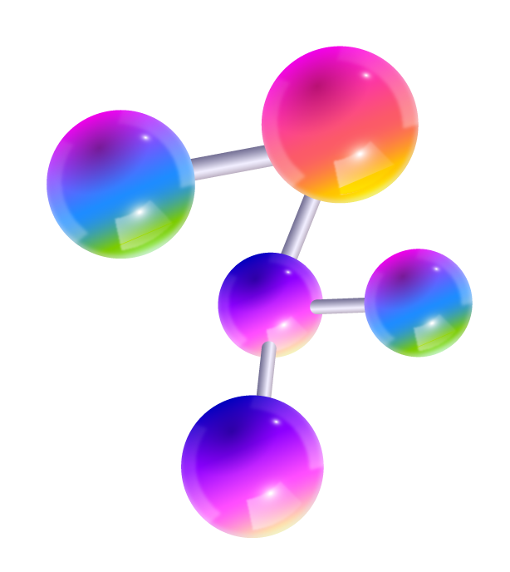
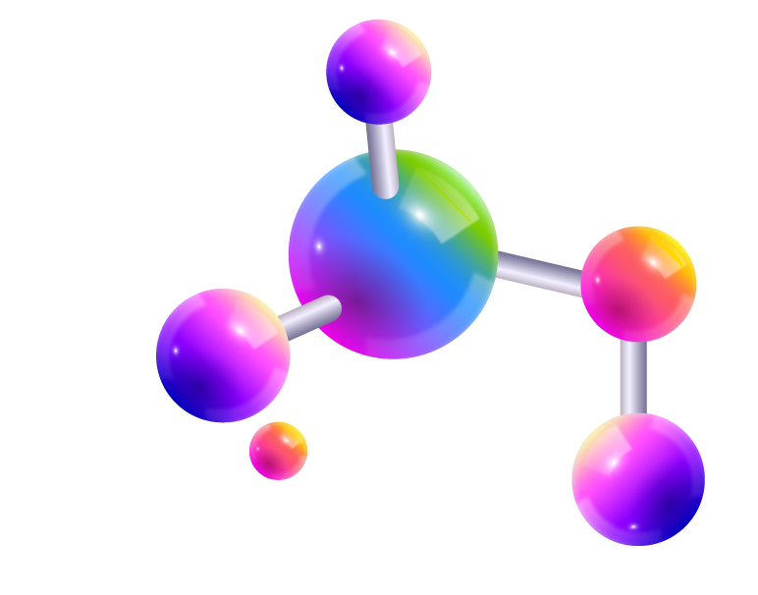
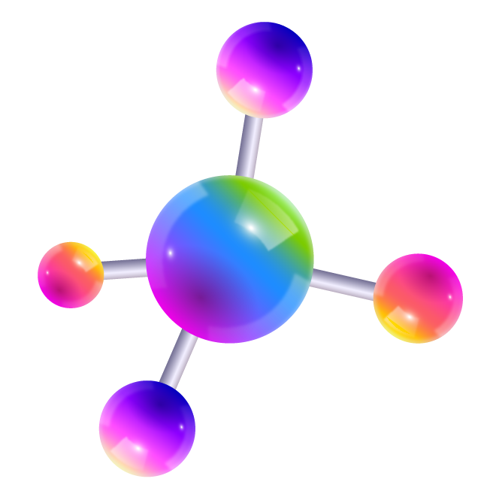
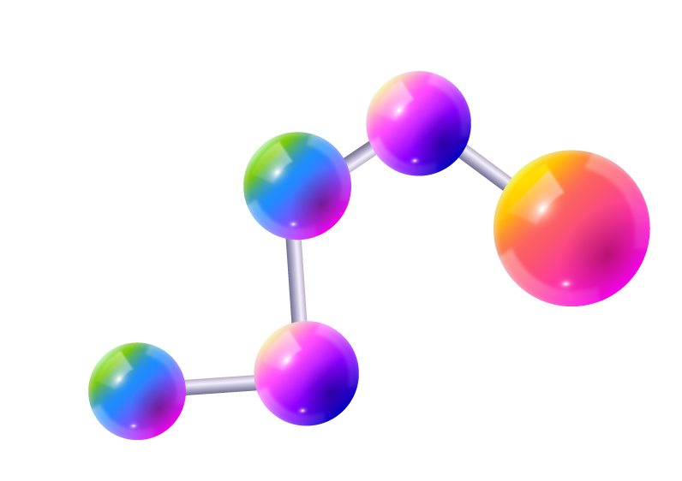
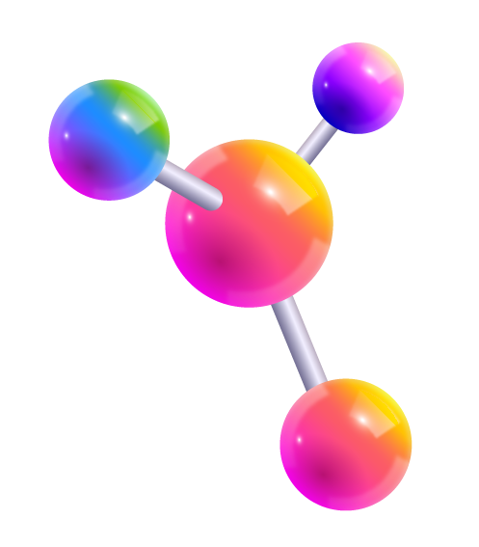
Alternative resources
Here’s an assortment of alternative resources whose style fits the one of this template:

